Slide 1
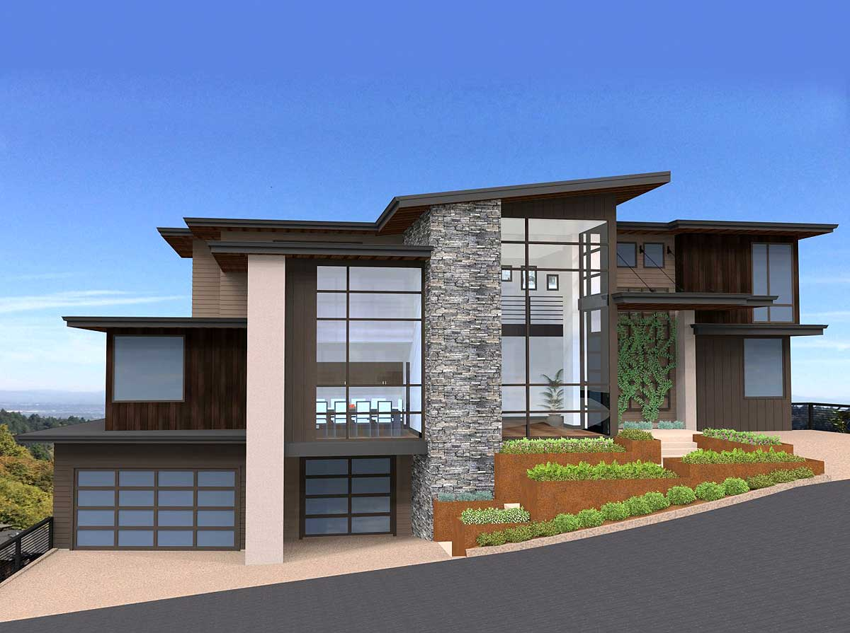
Solidity
SMART Contracts
Digital Real Estate Development / Management Team 1

Slide 2
Contents
Team 1- Dealerless Deals
Project Description
Development platform
Financial Transaction Management Solution
Demonstration(s)
Challenges

Slide 3
TEAM 1
Dealerless Deals Members:
Kowsalya Jeyabalan
Maitree Maniar
Cody Sifford
Nate Walker

Slide 4

Project Description

Slide 5
Project – 3 Description
Develop a digital real estate blockchain platform for the management of luxury homes investments, rentals, and sales.
Utilize Digital Token Technology to manage the distribution of real estate smart contacts.
Utilize computer algorithms, blockchain, location data, predictive analytics and more to help investors locate and sell properties, find renters and maximize their real estate investments.

Slide 6
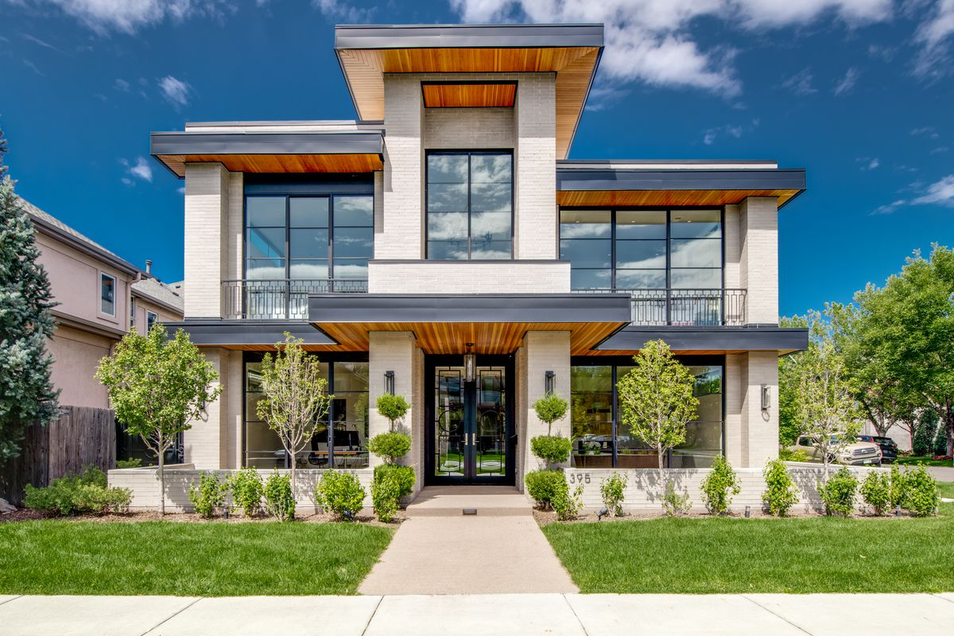
PROPERTY MANAGEMENT SOLUTIONS

Slide 7




Process OVERVIEW
Lease Agreement
5
Transfer of NFT
3
1
Property Listed
6
Available for Rental
Security Deposit
4
Auction
2

Slide 8
Property management solutions
Online Web Portal
Property listing management.
Smart Contracts:
Lease / Rental
Owner Tenants / Seller / Buyer
Document Management
Token Management
Bitcoin Payments

Slide 9
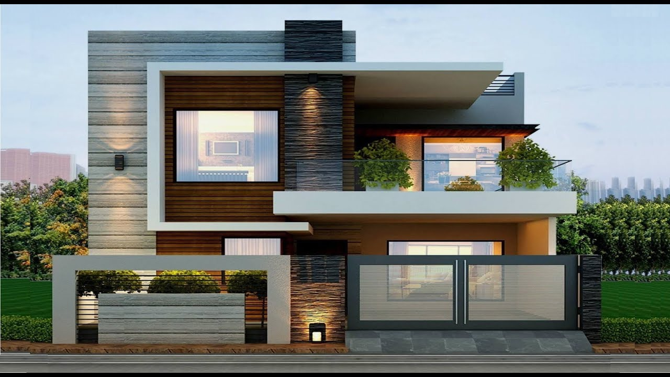
Development platform

Slide 10
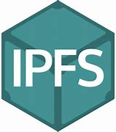





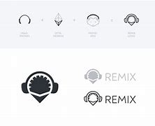

DEVELOPMENT PLATFORM
Notes:
The development platform- back-end interface includes: mycrypto that is talking to metamask, ganache, remix, and running solidity, python (Web3.py) , and github pages for the front-end interfacing.
Web3.py helps you access your Ethereum node from Python.
Making all of this possible is the InterPlanetary File System (IPFS), A communication Protocol.

Slide 11

Financial transaction management solution

Slide 12
Financial transaction management solution
Blockchain Technology
Bitcoin
Digital Tokens
Digital Wallet
Smart Contracts

Slide 13
FTMS – BLOCKCHAIN TECHNOLOGY

Slide 14
FTMS – BITCOIN

Slide 15
FTMS – DIGITIAL TOKENS
Fungible Tokens
ERC777 Standard
Crowdsale
Token Contracts
Non-Fungible Tokens
ERC721 Standard
Smart Contracts

Slide 16
FTMS – DIGITIAL WALLET

Slide 17
FTMS – SMART CONTRACTS

Slide 18



NEXT STEPS
Real-time Property Listing
To incorporate API for having the list of property available for Sale
Investment of Security Deposit
Include Option to invest the security deposit to ETFs, Mutual Funds.
Payment Features
Security Deposit to be adjusted for property damages, un-paid rents.
Credit Scoring
Credit check facility for Investors (Incase of Mortgage) and prospective tenants
Contract Duration
Flexible Contract Duration for Rentals

Slide 19

DEMONSTRATION
Notes:
Real Estate Tokenization

Slide 20
KEY CHALLENGES
Solidity
Automatic Activation of Contracts
Termination
Frontend Development
Difficult to modify what has been already registered
Everything about it
01
02
03
04
05
06
Connecting Contracts
Liability
Linking the Auction Contract with the Rental Contract
ERC X
Difficult to identify the person liable for damages
To understand the flow of new ERC X for Rental & Mortgage transactions

